Slide 1

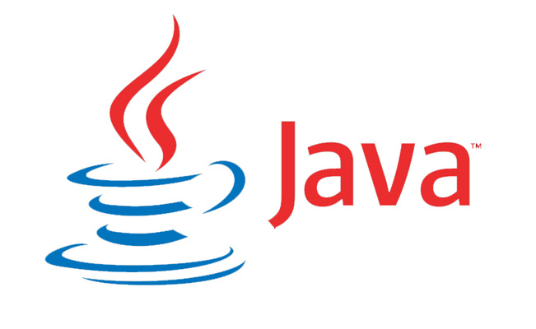
Introduction To Java
And Hello World

Slide 2
Java History
Developed By Sun Microsystems (merged with Oracle on January 27, 2010)
  Projected Headed By James Gosling, Mike Sheridan, and Patrick Naughton.
Originally named Oak and then changed to Green before becoming Java.
Developed in 1994. First stable release in 1995
Sun Microsystem’s Tag Line:
  “Write Once, Run Anywhere”
The Public’s Initial Reaction:
  “Write Once, Debug Everywhere”
Notes:
James Gosling: Carnegie Melon Graduate who focused his dissertation on Compilers and Mail Systems
Orignally named after the Oak tree that Gosling’s office faced. Later named after the fact that all three were compulsive coffee drinkers during the program’s development.

Slide 3
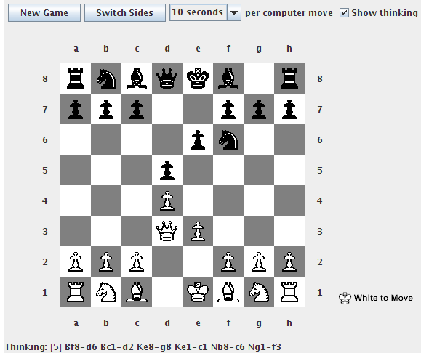
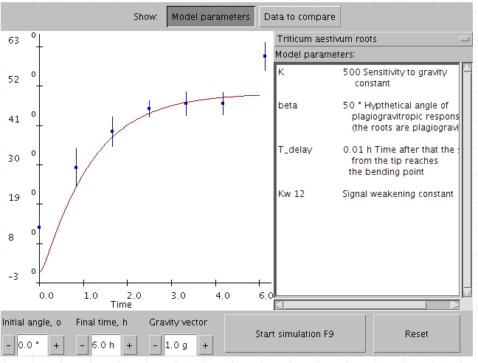
Java History
Perfect Timing
  The PC revolution occurred around the time Java was introduced. Java was quickly utilized for further development of online content (java applets) because of its device independent nature.
Notes:
James Gosling: Carnegie Melon Graduate who focused his dissertation on Compilers and Mail Systems
Orignally named after the Oak tree that Gosling’s office faced. Later named after the fact that all three were compulsive coffee drinkers during the program’s development.

Slide 4
Platform Independence
Capable of running on many types of computers (PCs, Macs, Unix and Linux, mainframes, cell phones, etc.)
    Sun Microsystems estimated that there were 5.5 million different java capable devices in 2010.

Slide 5
Platform Independence
How Does It Work?
Previous Thought: Create a compiler that can run on any platform.
Java Thought: Develop a method to have code translated into a language that all platforms could run without compiling on a specific machine.

Slide 6
Platform Independence
How Does It Work?
Editor
  Program used to type, review, and edit commands in a programming language
Java Code (.java)
  The source code of a Java program. The code written in the Java language
Compiler
  A program that processes statements written in a particular language and turns them into machine language that a processor uses
Byte code (.class)
  Machine code that is created after the java language has been compiled

Slide 7
Platform Independence
How Does It Work?
Java Runtime Environment (JRE)
  Acts as an Emulator – Sets aside part of your hard drive to act like a computer that can execute Java Programs
  Offers all classes needed to enable the JVM to run your program
Java Virtual Machine (JVM)
  Part Of The JRE
  A Hypothetical Computer Platform – A design for a computer that does not exist as actual hardware
  Acts as the “processor” which processes your program instructions.

Slide 8
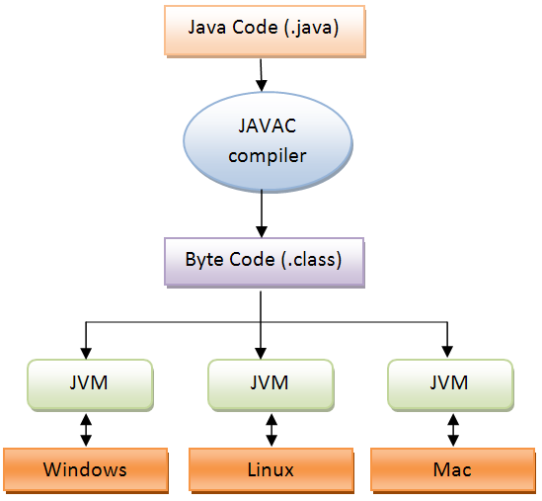
Platform Independence
How Does It Work?

Slide 9
Object-Oriented Programming
Java Is Inherently Object-Oriented
    Objected-Oriented: a programming entity that represents either some real-world object or an abstract concept.
Objects have two basic characteristics
  Objects Have Data, also known as state.
    An object that represents a book has data such as the book’s title, author, and publisher
  Objects also have behavior which means that they can perform certain tasks. These tasks are called methods.
    Methods for a car may be start, stop, drive, and crash.

Slide 10
Object-Oriented Programming
Classes are closely related to objects
  Classes: the program code that you write to create objects.
    The class describes the data and methods that define the object’s state and behavior.
    When the program executes, classes are used to create objects.

Slide 11
Object-Oriented Programming
    Example: The Payroll
      The program needs objects to represent the company’s employees
      The program would include a class called Employee that defines the data and methods for each Employee object.
      When the program runs it uses this class to create an object for each of your company’s employees

Slide 12
The Java API
Java Application Programming Interface: a library of classes that provide commonly used utility functions that most Java programs can not do without.
The Java Language has 50 Keywords
The Java Language has several thousand classes.

Slide 13
Features of Java
Type Checking: The way that a language handles variables that store different types of data.
Java does complete type checking at runtime.
Automatic Memory Management: You do not have to explicitly release memory when you are done with it.
  The Java Virtual Machine has a special process called the garbage collector that determines when data is no longer being used and automatically deletes that data.
  The result, speedier computing.

Slide 14
Features of Java
Exception Handling
  The Java Runtime Environment intercepts and folds errors of all types into a special type of object called an exception object.
  Java requires that any statement that can potentially cause an exception be bracketed by code that can catch and handle the exception.
  When programming in Java you must anticipate errors that can occur while your programming is running.

Slide 15
The Downside
The API (Application Programming Interface) is gigantic.
Some API classes are over complicated
Java does not directly support decimal data.
  Without special coding, Java does not know how to add.

Slide 16
HELLO WORLD

Slide 17
Hello World
public class HelloApp
{
public static void main (String [] args)
{
System.out.println ("Hello, World!");
}
}

Slide 18
Hello World
public class HelloApp
A Keyword of the Java Language.
States that the elements that follow (a class named HelloApp) should be made public
Public = Accessible To Other Classes

Slide 19
Hello World
public class HelloApp
A Keyword Of The Java Language
Indicates That The Element Defined Here Is A Class.
    All Java Programs Are Made Up Of One Or More Classes.
A class definition contains code that defines the behavior of the objects created and used by the program.

Slide 20
Hello World
public class HelloApp
An Identifier* that provides the name for the class being defined here.
Unlike keywords, Identifiers are words that YOU create.
Identifiers provide names for various elements that you use in your program.
*Though Identifier is the correct term it is sometimes referred to as a symbol or name.

Slide 21
Hello World
public class HelloApp
{
public static void main (String [] args)
{
System.out.println ("Hello, World!");
}
}
{ and }: Define the beginning and end of the Body of the class. Everything between these brackets belong to the class.

Slide 22
Hello World
public class HelloApp
{
public static void main (String [] args)
Public keyword is used to indicate that a METHOD should have public access.
Classes other than HelloApp can use it.
All Java programs must have at least one class that declares a public method named main.
  The main method contains the statements that are executed when you run the program
  Method: a unit of code that can calculate and return a value

Slide 23
Hello World
public class HelloApp
{
public static void main (String [] args)
The Java language requires that you specify static when you declare the main method
  Static to be explained in future lessons.

Slide 24
Hello World
public class HelloApp
{
public static void main (String [] args)
Specifies the main method will not return a value
  Method: a unit of code that can calculate and return a value

Slide 25
Hello World
public class HelloApp
{
public static void main (String [] args)
The identifier that provides the name of the method
As previous stated, Java requires that this method be called main
When creating other methods you can name them anything that will help you with proper organization and workflow.

Slide 26
Hello World
public class HelloApp
{
public static void main (String [] args)
Parameter List: Used to pass data to the method.
You have to code (String [ ] args) on the declaration for the main methods in ALL of your Java programs
A further explanation of Parameter List will come in the future.

Slide 27
Hello World
public class HelloApp
{
public static void main (String [] args)
{
System.out.println ("Hello, World!");
}
}
These brackets mark the body of the main method.
Whenever you come to a closing bracket it is paired with the most recent opening bracket that has not been closed.

Slide 28
Hello World
public class HelloApp
{
public static void main (String [] args)
{
System.out.println ("Hello, World!");
The only statement in the entire program!
Calls a method named println that belongs to the System.out object

Slide 29
Hello World
public class HelloApp
{
public static void main (String [] args)
{
System.out.println ("Hello, World!");
This method displays a line of text on the console.

Slide 30
Hello World
public class HelloApp
{
public static void main (String [] args)
{
System.out.println ("Hello, World!");
The text to be displayed is passed to the println method as a parameter in parentheses following the word println.
The text is the string literal Hello, World! Therefore those characters are displayed on the console

Slide 31
Hello World
public class HelloApp
{
public static void main (String [] args)
{
System.out.println ("Hello, World!");
In Java, most (but not all) statements must end with a ;
As this is the only statement in the program this is the only line that requires a ;

Slide 32
Hello World
public class HelloApp
{
public static void main (String [] args)
{
System.out.println ("Hello, World!");
}
This closing bracket marks the end of the main method body

Slide 33
Hello World
public class HelloApp
{
public static void main (String [] args)
{
System.out.println ("Hello, World!");
}
}
This bracket marks the end of the HelloApp class.
As this program consists of one class, this line also marks the end of the program.

Slide 34
Hello World
public class HelloApp
{
public static void main (String [] args)
{
System.out.println ("Hello, World!");
}
}

Slide 35
Java Basics Continued

Slide 36
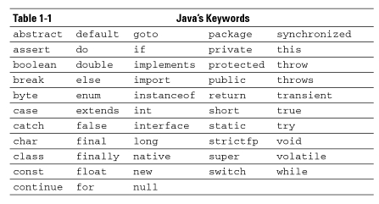
Keywords
Public, class, static, and void were all used in HelloWorld
true, false, and null are considered literals.
    Literals are reserved for the Java language and work in a similar way to keywords
const and goto are reserved by the java language but do not do anything (they are carryovers from C++)

Slide 37
Working With Statements
Like many other programming languages, Java uses statements to build programs.
Unlike most other languages, Java does not use statements as its fundamental unit of code (it uses classes)

Slide 38
Examples Of Statements
Declaration statements: create variables that can be used to store data
int I;
String s = “This is a new string”;
Customer c = new Customer ( ) ;

Slide 39
Examples Of Statements
Expression statements: perform calculations
i = a + b
salesTax = invoiceTotal * taxrate;
System.out.println (“Hello, World!”) ;
Expression Statements In Action: the last statement in this group is the same as line 5 of HelloApp

Slide 40
Examples Of Statements
if-then statements: execute other statements only if a particular condition has been met
for, while, and do statements: execute whole groups of statements one or more times.

Slide 41
; and Statements
When piecing together a statement, many must end with ;
  Declaration and Expression statements must end with a ;
  Most other statement types do not need a ;
    The java compiler will let you know if you should not use a ;
  if statement if (total > 100)
  expression statement discountPercent = 10;

Slide 42
White Space/Workflow
White space: one or more consecutive space characters, tab characters, or line breaks.
Within Java, all white space is considered the same whether it is one space or 15 line breaks.

Slide 43
White Space/Workflow
All of the following statements will function the same way:
x = (y + 5) / z;
x =
(y + 5) / z;
x
=
(
y
+
5
)
/
Z
;

Slide 44
White Space/Workflow
All of the following statements will function the same way:
public static void main (String [] args)
public
static
void
main
(String [] args)
Exceptions: You can not put white space between keywords or identifiers
p u b l i c static v o i d main (String [] args) will not work

Slide 45
The Importance Of White Space
When developing lengthy code white space becomes important
  Use line breaks to separate statements
  Use tabs to line up elements that belong together
  When you start to program regularly you will develop your own methods.
  Remember that these methods SHOULD help you better organize your ideas for easier access and editing

Slide 46
Working With Blocks
Block: a group of one or more statements that is enclosed in braces { }. A block can contain one or more statements.
{
int i, j;
i = 100;
j = 200;
}
A block itself is a type of statement. Anytime the Java language requires a statement you can substitute a block.
Though a block is a type of statement it shouldn’t end with a ;

Slide 47
Creating Identifiers
Identifier: a word used to refer to a Java programming element by name.
  Identifiers are most used for the following elements:
    Classes (HelloApp)
    Methods (main)
    Variables and fields (hold data used by your program)
    Parameters (pass data values to methods)

Slide 48
Creating Identifiers
Important things to remember about Identifiers:
  Case-sensitive: SalesTax, Salestax, and salesTax are all distinct identifiers
  Can be made up of uppercase and lowercase letters, numerals, underscore characters (_), and dollars signs ($). Examples: Sales_Tax, sale$Tax, Sa1esTax
  All identifiers must begin with a letter (sadly $alesTax will not function as an identifier)
  Identifiers can not be the same as ANY Java keywords (say goodbye to public, transient, and package)
  Watch out for bling: it is recommended that you avoid using $ in your identifiers because code generators use $ to create identifiers. Avoiding $ may help prevent conflicts with generated names.

Slide 49
Crafting Comments
Comments: text that provides explanations of your code which is formatted in a specific way to avoid compiling errors.
Java Has 3 Basic Types Of Comments:
  End-of-line Comments
  Traditional Comments
  Javadoc Comments

Slide 50
Crafting Comments
End-of-line Comments
  Typically used to explain the purpose of a particular line
  Begin with the sequence / / (everything typed after those two slashes is ignored by the compiler)
  End at the end of the line
  Can be placed at the end of ANY line
  total = total * discountpercent; // calculate the discounted total

Slide 51
Crafting Comments
End-of-line Comments
  Typically used to explain the purpose of a particular line
  Begin with the sequence / / (everything typed after those two slashes is ignored by the compiler)
  End at the end of the line
  Can be placed at the end of ANY line
  Typical End-of-line comment
  total = total * discountpercent; // calculate the discounted total
  Separate Line End-of-line comment
  // calculate the discounted total
  total = total * discountpercent;

Slide 52
Crafting Comments
End-of-line Comments
  Typically used to explain the purpose of a particular line
  Begin with the sequence / / (everything typed after those two slashes is ignored by the compiler)
  End at the end of the line
  Can be placed at the end of ANY line
  Middle Of Statement End-of-line Comment
  total = (total * discountpercent) // calculate the discounted total first
  + salestax: // then add the sales tax

Slide 53
Crafting Comments
Traditional Comments
  Typically placed at the beginning of a class to indicate its function, purpose, and/or additional information about it (author, year it was written, etc.)
  Begin with the sequence /*
  End with */
  Can span multiple lines
  Can begin and end ANYWHERE on a line (as long as your required code is not within it)

Slide 54
Crafting Comments
Traditional Comments
  Typically placed at the beginning of a class to indicate its function, purpose, and/or additional information about it (author, year it was written, etc.)
  Begin with the sequence /*
  End with */
  Can span multiple lines
  Can begin and end ANYWHERE on a line (as long as your required code is not within it)
  /* This class makes the words “Zlomek 4 Lyfe” appear on the console. Ryan Zlomek wrote, or rather stole, this code in order to make it appear that he knew how to code. This occurred sometime in 2013 though no one can be sure when. If he is to keep up this pace he might be able to build an app by the time he graduates from life. Good day y’all. */
  public class helloworld
  {
  public static void main (String [] args)
  {
  System.out.println (“Zlomek 4 Lyfe");
  }
  }

Slide 55
Crafting Comments
Traditional Comments
  Typically placed at the beginning of a class to indicate its function, purpose, and/or additional information about it (author, year it was written, etc.)
  Begin with the sequence /*
  End with */
  Can span multiple lines
  Can begin and end ANYWHERE on a line (as long as your required code is not within it)
  One bad habit: Some people use Traditional comments to block out code for temporary compiling. This WILL NOT work if there is a traditional comment within it.
  /*
  int x, y, z;
  y = 10;
  z = 5;
  x = (y + /* a strange place for a comment */ 5) / z;
  */

Slide 56
Crafting Comments
JavaDoc Comments
  A special type of Traditional Comment used to automatically create web-based documentation for a program.
  This type of comment is to be explained further when we get to specific Object-Oriented concepts.

Slide 57
Comment Fiddling
Take a look at your HelloApp program and start to implement End-of-line and Traditional comments into it.
Test different methods and see what you can incorporate
Try making intentional errors to see how the compiler deals with them.

